Slide 1
E Commerce Site
Submitted By: Deepak Kumar(11703019)
Manik Dahuja(11703070)

Slide 2
What is E-Commerce?
> Activity of Buying or Selling products online
> B2B
> B2C

Slide 3
Technologies Used:
. HTML
.CSS
.Javascript
.J-Query

Slide 4
Github Link
https://github.com/deepakkumar4321/Front-end

Slide 5

Home Page

Slide 6
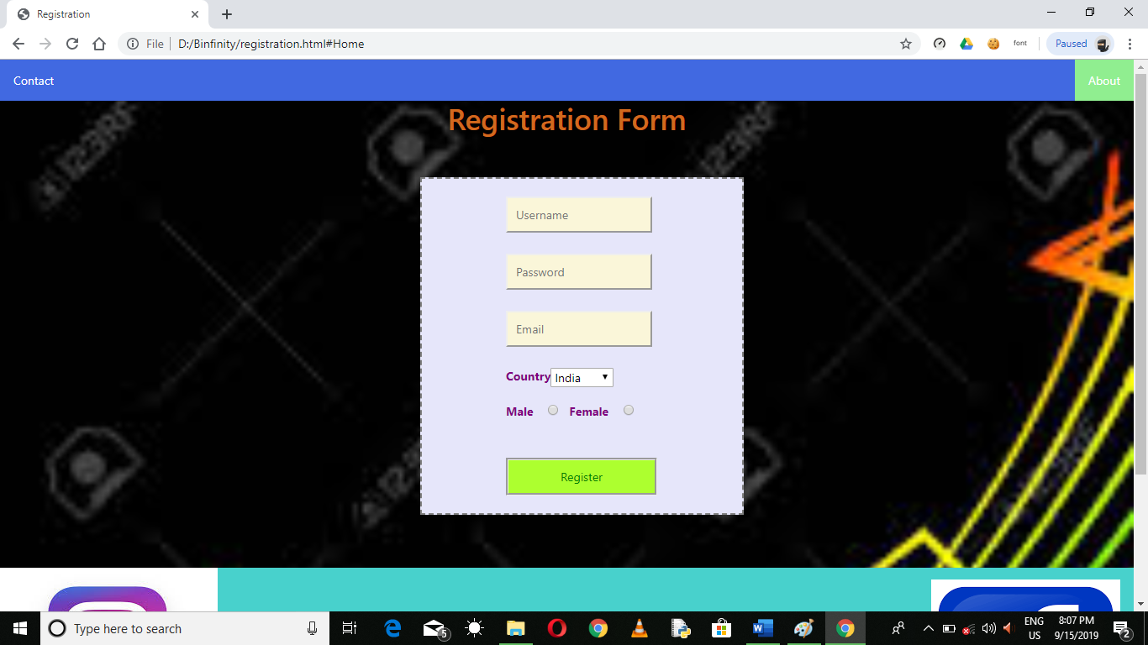
Login Page

Slide 7
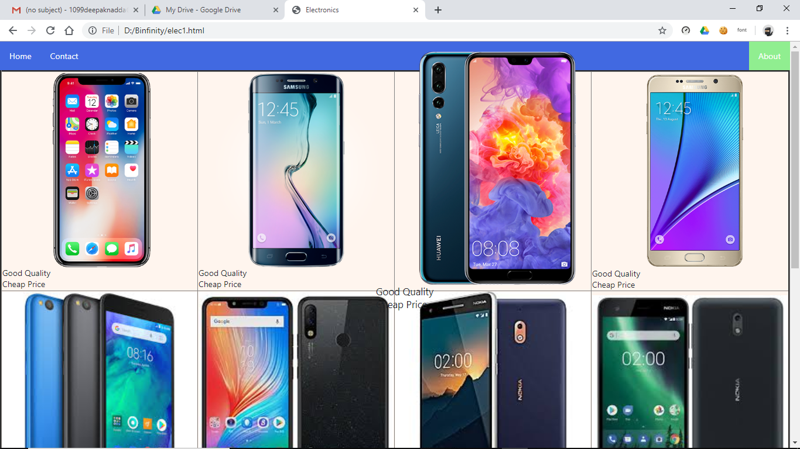
Electronics Page

Slide 8
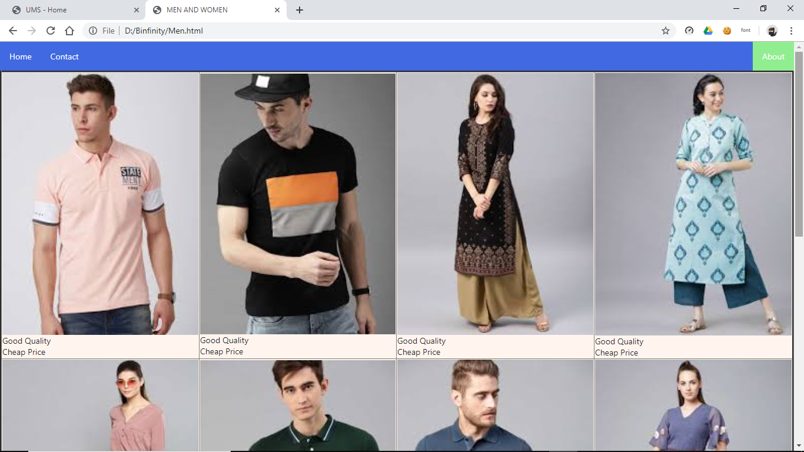
Clothes

Slide 9
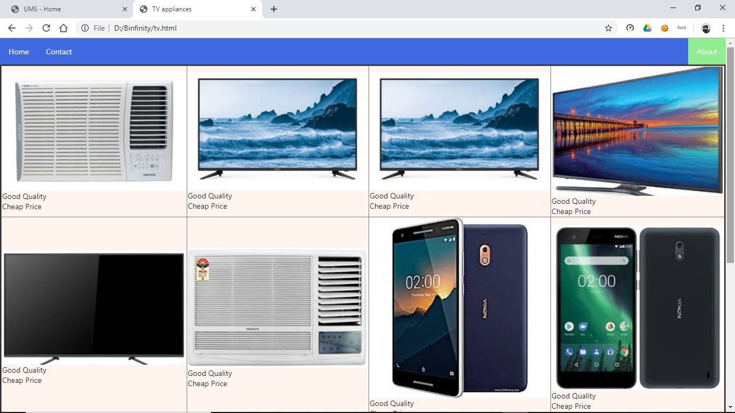
Home & Furniture

Slide 10
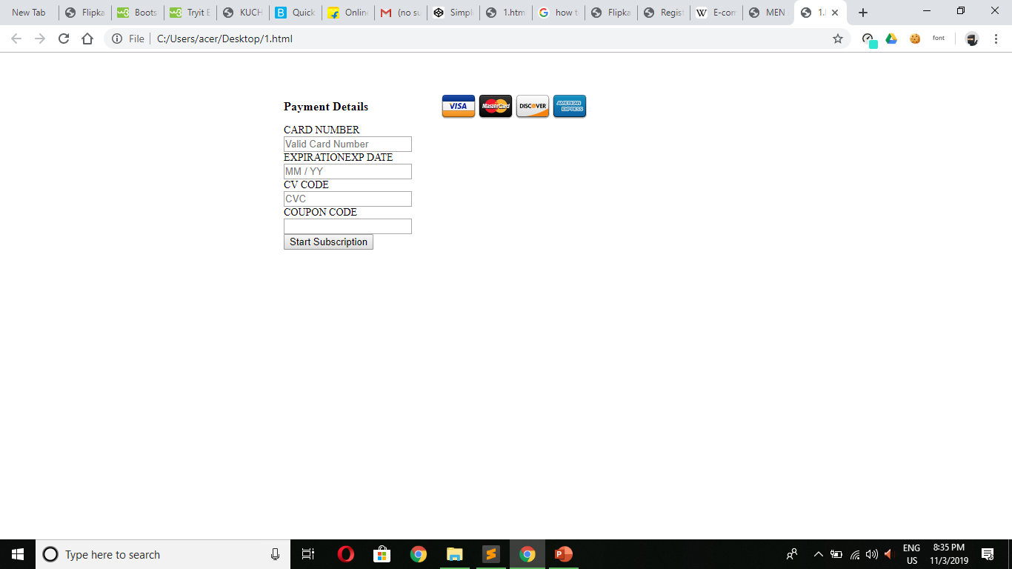
Billing Page

